Slide 1
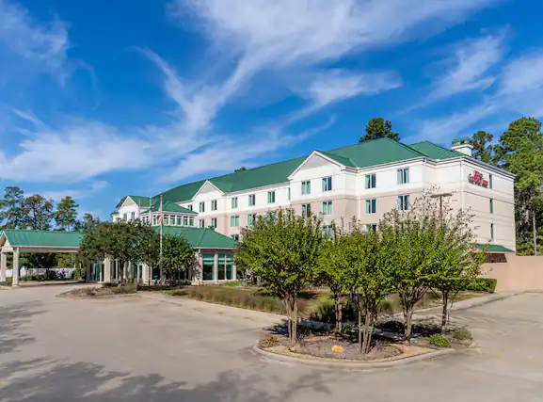
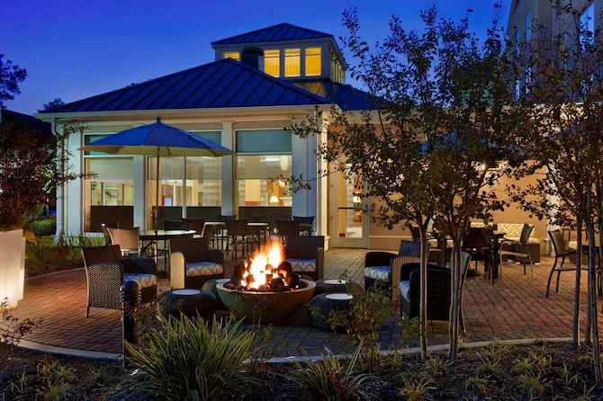
Hilton Garden Inn/The Woodlands

Slide 2
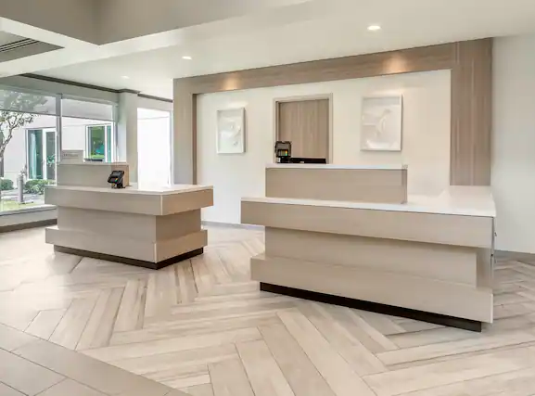
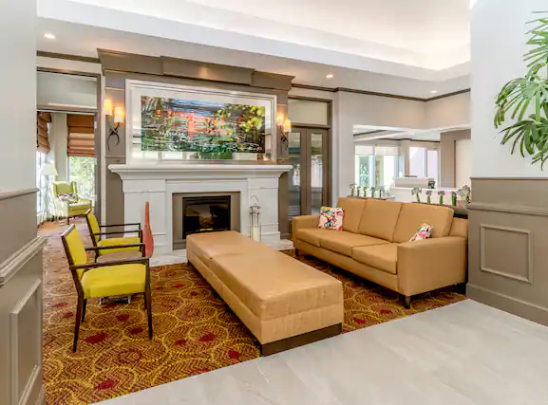
Lobby: Check-in at 3pm Check-out at 12pm “The Shop” open 24h (Food & Beverage available) (If you have any special request, please let us know, and we will be more than happy to accommodate you!!)

Slide 3
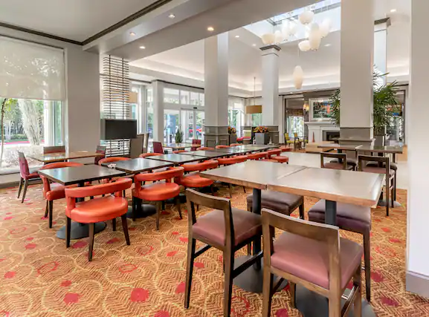
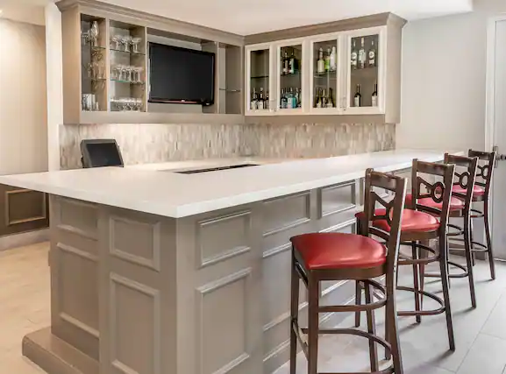
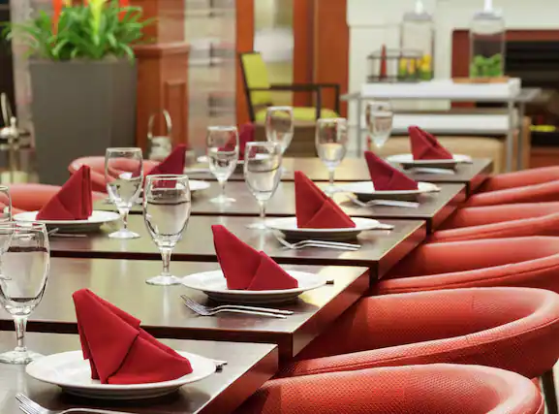
Breakfast: Hot Buffet breakfast available ($9.74 per person) Hours: 6am-10pm during the week 7am-11am during the weekend Inside Bar available 5pm- 10pm

Slide 4
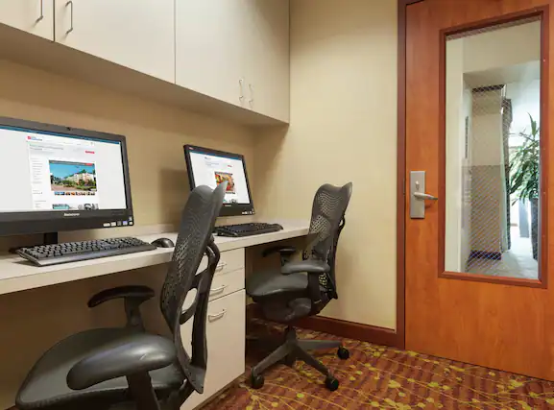
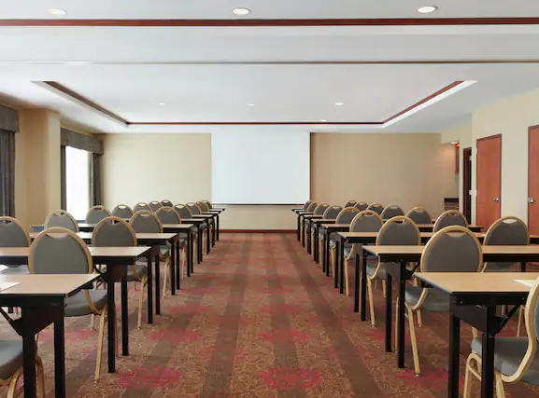
Amenities: Business Center available 24h Complimentary Wi-Fi Complimentary Parking Outdoor pool

Slide 5
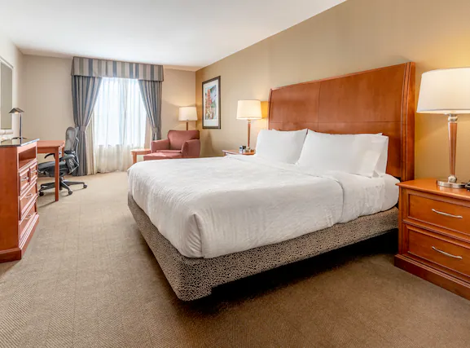
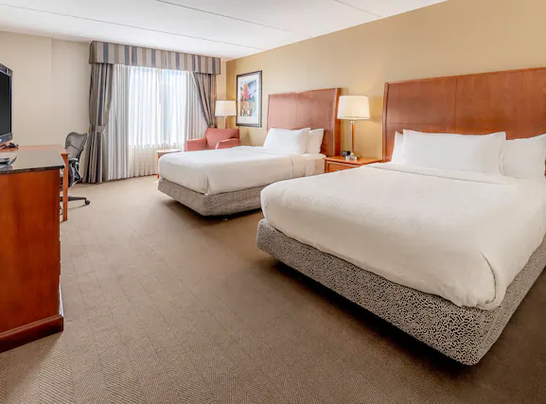
Rooms: Microwave included Fridge Included Keurig- Coffee maker included Iron board & Hair dryer included Safe box included

Slide 6
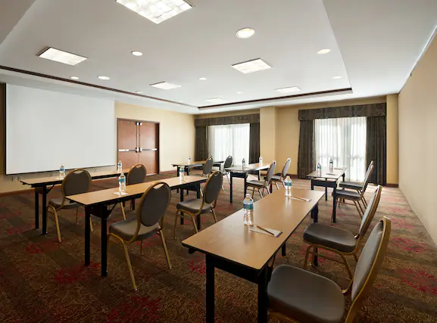
Meeting Spaces: .Pines Ballroom (1,650 s/f) .The Library Board Room (350 s/f) .The Magnolia Board Room (300 s/f)

Slide 7
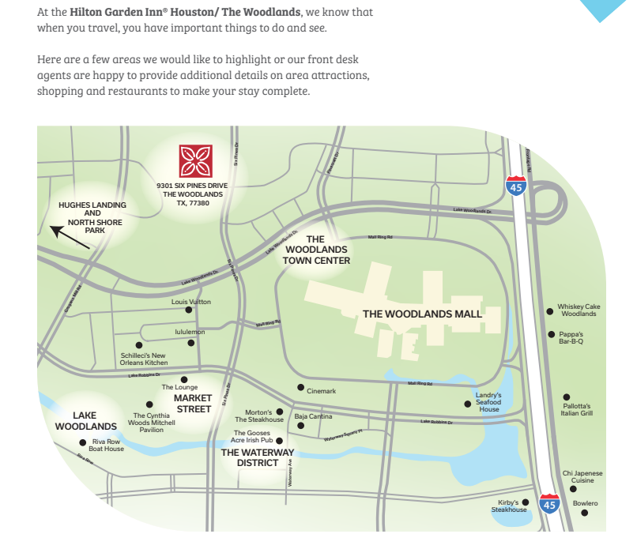
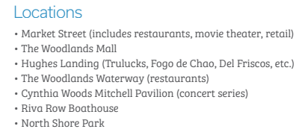
9301 Six Pines Dr, The Woodlands TX, 77380.

